Slide 1
Encouraging Food Sustainability with Natural Language Processing
Eugene Lee and Brandon Chenze
Dr. Panangadan

Slide 2
Outline
01
03
05
02
04
06
Purpose
Results
Future Work
Challenges
Conclusions
Questions

Slide 3
Purpose
In the United States, 108 billion pounds of food is wasted every year.

Slide 4
Statistics
40%
43%
12.5%
Of all food in America is wasted.
Of that food comes from homes.
Of Americans, 42 million people, may experience food insecurity in 2021.

Slide 5
Inspiration!
If we get people to think about food waste, is that enough to help combat it?

Slide 6
Project Outline
Create a chatbot that encourages food sustainability practices on Twitter.
Use FoodKeeper dataset to tell users about food shelf life or give cooking tips.
Notes:
700 different types of food in Food Keeper
Questions we had:
How do we create a chatbot that tweets like a human?
How do we identify food in tweets? Because the bot
How do we tell the difference between between a “cheesy movie” and “cheesy pizza”?
What even are sustainability practices?

Slide 7
Process
Match Tweet to database with food tips
Stream live Tweets
Determine relevance
Tweet back message with food tips
Notes:
Food Keeper:
Shelf life
Cooking tips
Cooking methods

Slide 8
Challenges
Popular NER models not trained to look for food entities.
Food social media datasets don’t exist.
People don’t like talking to bots.
Notes:
Well known open source NER models don’t recognize food entities
Specifically: Knowledge base, nltk, Stanford NER

Slide 9
How we addressed challenges
Trained Custom NER
Scraped Twitter for 38,000 tweets
Leverage expectations
Notes:
spacy -> open source NLP framework based on Transformer architecture
Food keeper keywords: Buttermilk, cheese, cheddar, etc...

Slide 10
Results

Slide 11

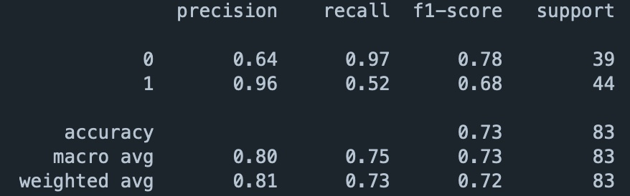
Metrics
Food NER achieved 73% accuracy on test set.
Notes:
Test set size = 83 manually labelled tweets
Similar research on Reddit to create custom NER yielded 75% accuracy on initial tests & 82% accuracy after tuning

Slide 12
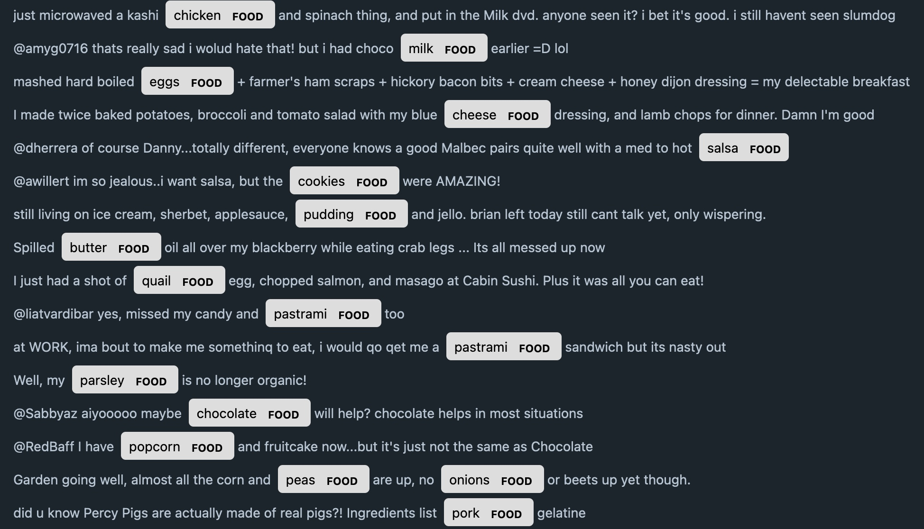
True Positives
Notes:
700 different types of food in Food Keeper
38 true positives

Slide 13
False Positives
Only 1.
Maybe surprising given how we collected training data.

Slide 14
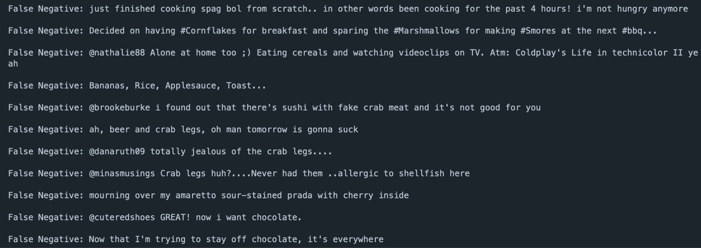
False Negatives
Notes:
700 different types of food in Food Keeper
In total: 21 false negatives

Slide 15
Conclusions & Future Work

Slide 16
Conclusions
Results are comparable to first iteration of similar work.
Model suffered from a large number of false negatives.
False positives were surprisingly not a significant issue.

Slide 17
Future Work
Upload curated dataset to open source repositories.
Retrain model to factor in punctuation & capitalization.
Have multiple researchers hand label test data to ensure consensus.
Build out the rest of the pipeline, specifically the chat bot.

Slide 18
Resources
https://www.feedingamerica.org/our-work/our-approach/reduce-food-waste
https://www.forbes.com/sites/gilpress/2019/10/02/ai-stats-news-86-of-consumers-prefer-to-interact-with-a-human-agent-rather-than-a-chatbot/?sh=294c396e2d3b
Ritter, Alan, Sam Clark, and Oren Etzioni. "Named entity recognition in tweets: an experimental study." Proceedings of the 2011 conference on empirical methods in natural language processing. 2011.
John Lu, Sumati Sridhar, and Ritika Pandey, Mohammad Al Hasan, George Mohler. 2019. Investigate Transitions into Drug Addiction through Text Mining of Reddit Data. In KDD ’18: ACM SIGKDD Conference on Knowledge Discovery and Data Mining, August 04–08, 2019, Anchorage, AK. ACM, New York, NY, USA, 9 pages. https://doi.org/10.1145/1122445.1122456

Slide 19
Questions
https://github.com/eugenelee123/twitter_food_bot

Slide 20
Thanks
CREDITS: This presentation template was created by Slidesgo, including icons by Flaticon, infographics & images by Freepik
Please, keep this slide for the attribution

